Slide 1
Brussels, Belgium | March 9, 2020
Migrant Integration Policy Index
2020 Norway launch
Thomas Huddleston,
Research Director
Migration Policy Group
Notes:
10 minutes The Migration Policy Group (MPG) has a long-standing commitment to immigrant political participation and extensive experience of training and pilots

Slide 2

What is Migration Policy Group?
For 25 years, MPG’s mission has been to achieve lasting progress towards more open and inclusive societies.
MPG is focused on informing the policy and legal agenda on anti-discrimination, integration and legal migration, while contributing to all activities that bolster the resilience of the sector.
We create data-driven resources, collect evidence in a pan-European manner, organise campaigns, and engage in extensive outreach.

Slide 3
What is MIPEX?
Most comprehensive tool to compare integration policies:
  Number of indicators
  Methodology with national experts & checks
  Longitudinal scope (2007-2019)
  Thematic scope (including health)
  Geographic scope (52 countries)
Most cited international benchmark used by global actors, NGOs, media & researchers
  Example: Draft Global Compact on Migration recommended participation of all States in MIPEX to identify challenges & best practices Compact for Safe, Orderly and Regular Migration – Draft REV 1,« 26 March 2018, section 30(a), p. 18).

Slide 4
What is MIPEX?
Use of core indicators captures country’s approach to integration on 3 dimensions: basic rights, equal opportunities & long-term security
  Top Ten countries
  Comprehensive integration
  Temporary integration
  Equality on paper
  Immigration without Integration
Links between policies & outcomes: 130 peer reviewed scientific studies linking MIPEX to integration outcomes for immigrants & the public

Slide 5
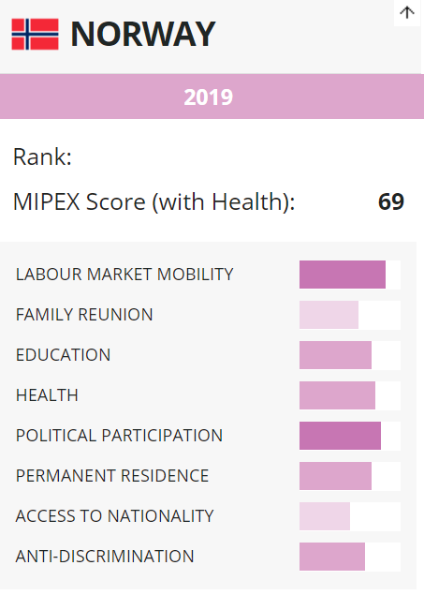
Results: NO is comprehensive, but 2nd tier…
www.mipex.eu/norway

Slide 6
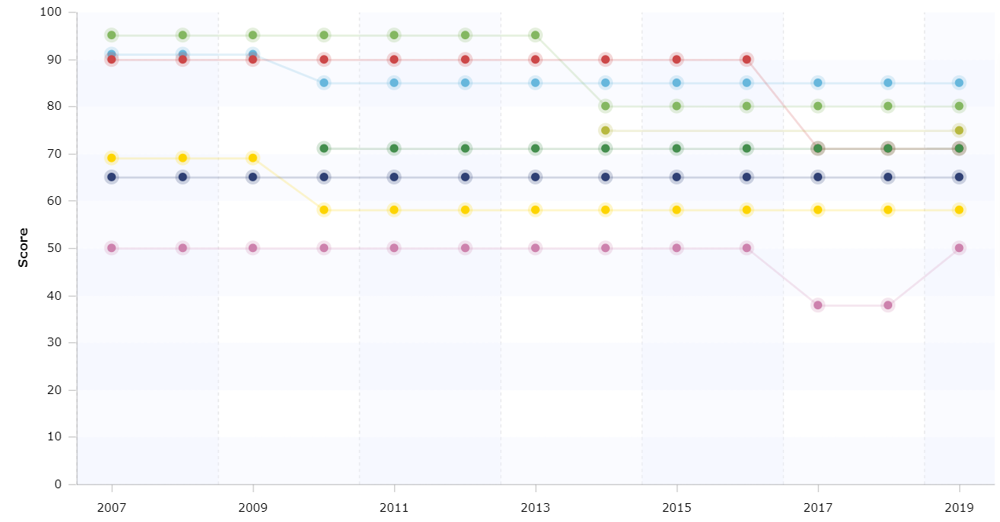
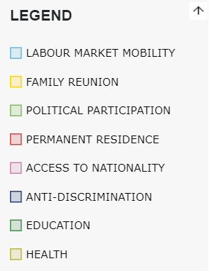
2014-2019: -3 (72 to 69), NO falls out of Top 10
Equal rights & opportunities, but not equal security for newcomers

Slide 7
MIPEX links integration policies & outcomes
Integration as two-way process

Slide 8
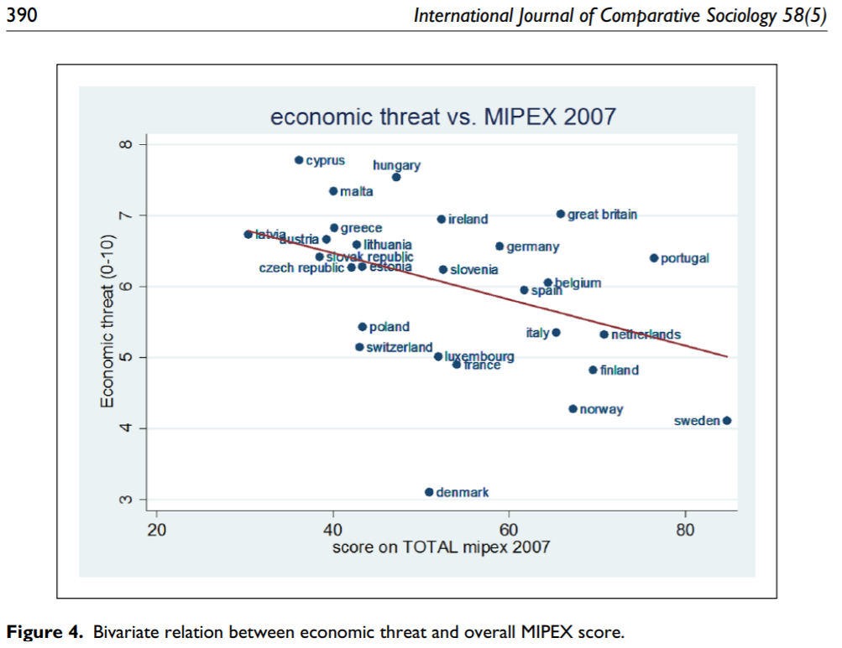
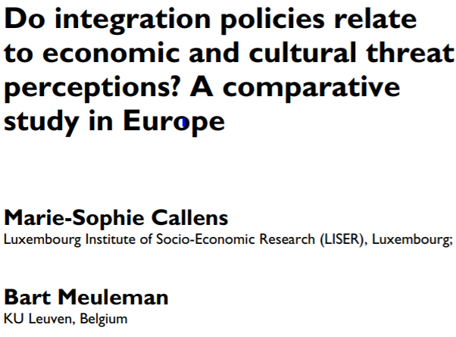
Dozens of studies link policies & public opinion

Slide 9
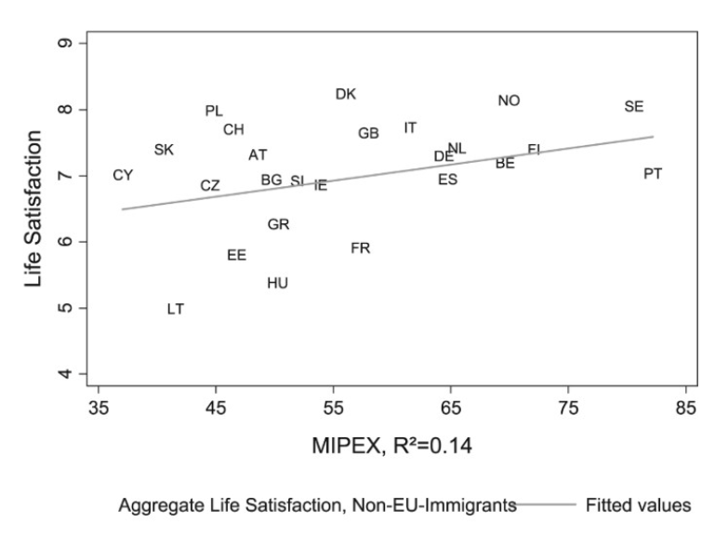

New studies link policies & immigrant attitudes

Slide 10
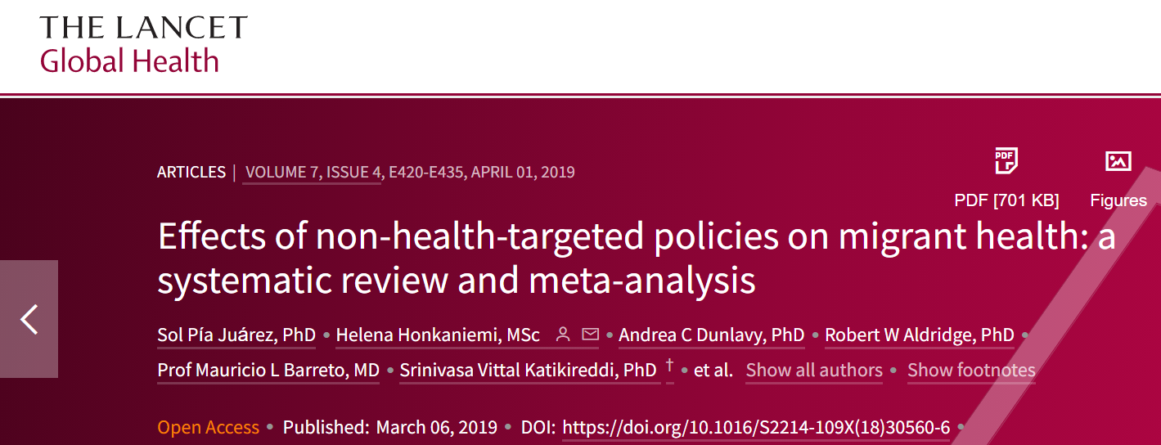
Dozen studies link policies & migrant health

Slide 11
MIPEX links integration policies & outcomes
Long-term security

Slide 12
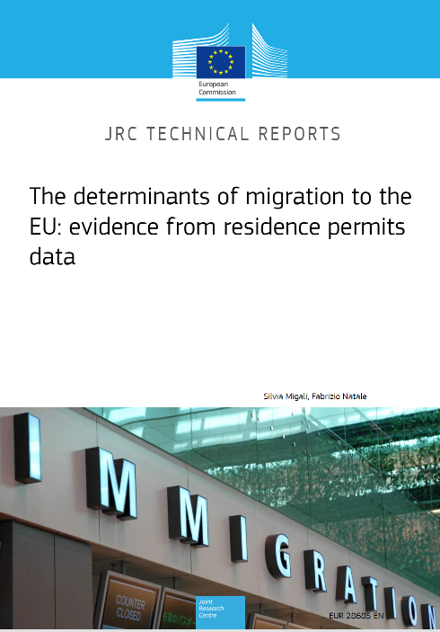
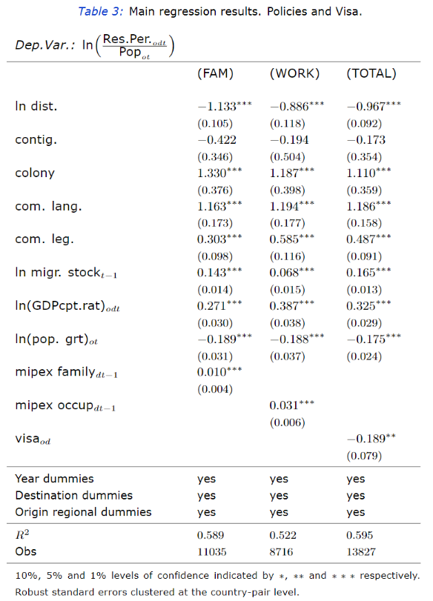
Study links family reunion policy & rates

Slide 13
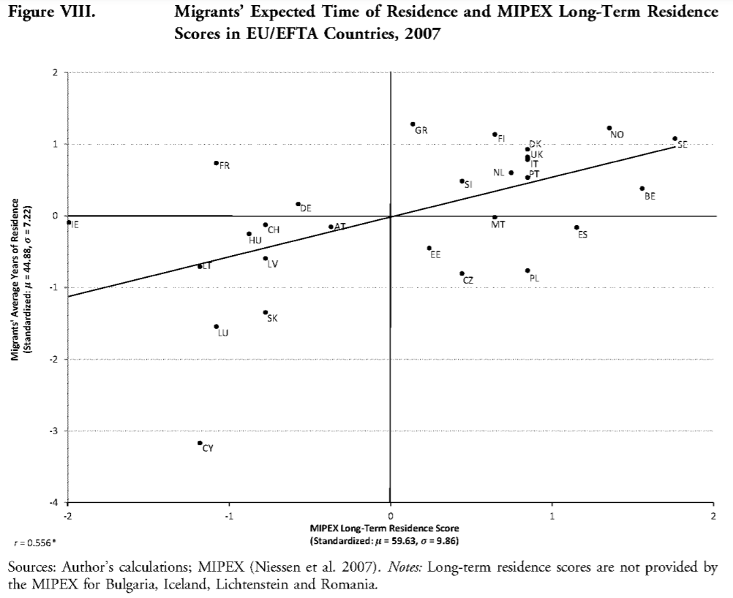
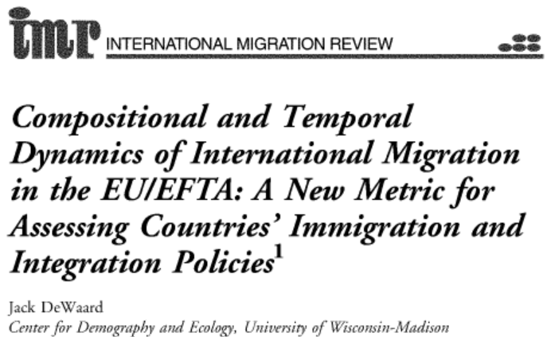
Study links perm. residence policy & rate

Slide 14
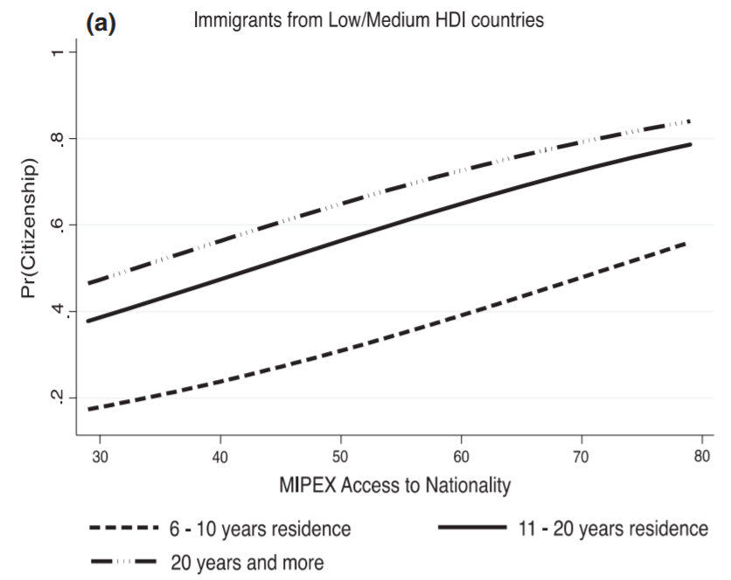
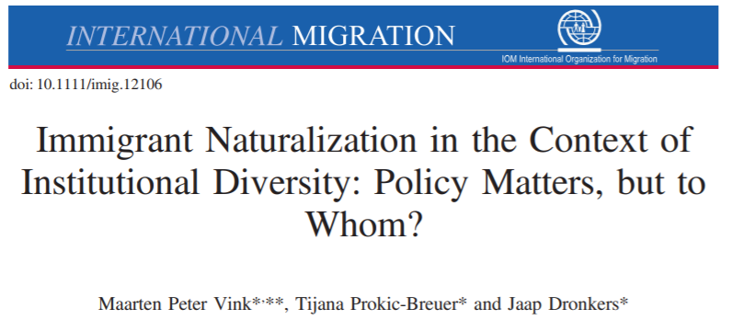
Studies links naturalisation policy & rates

Slide 15
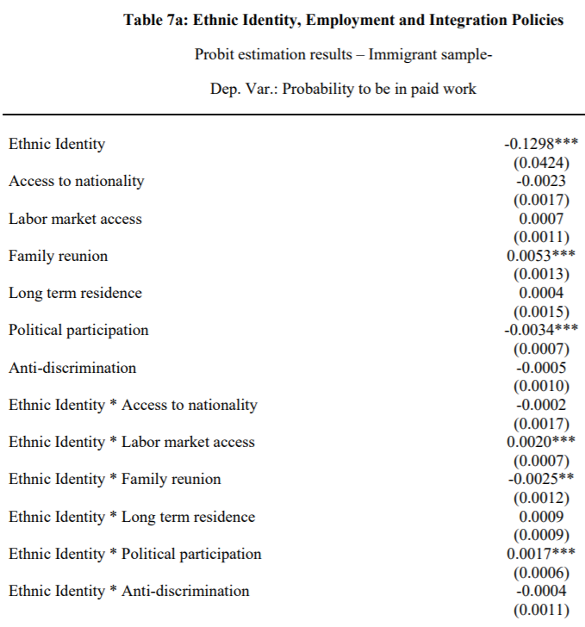
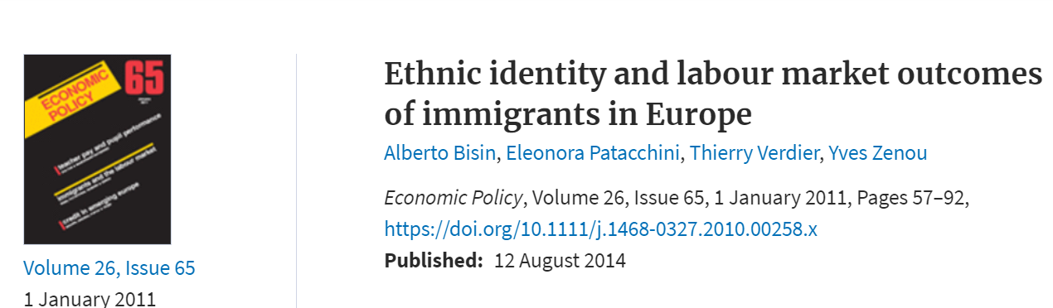
Few studies not yet conclusive on links between long-term security & (quality) employment

Slide 16

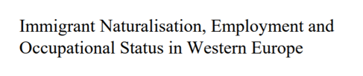
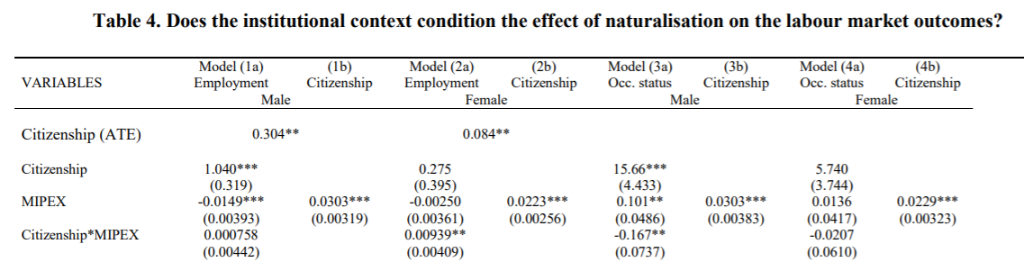
Few studies not yet conclusive on links between long-term security & (quality) employment

Slide 17
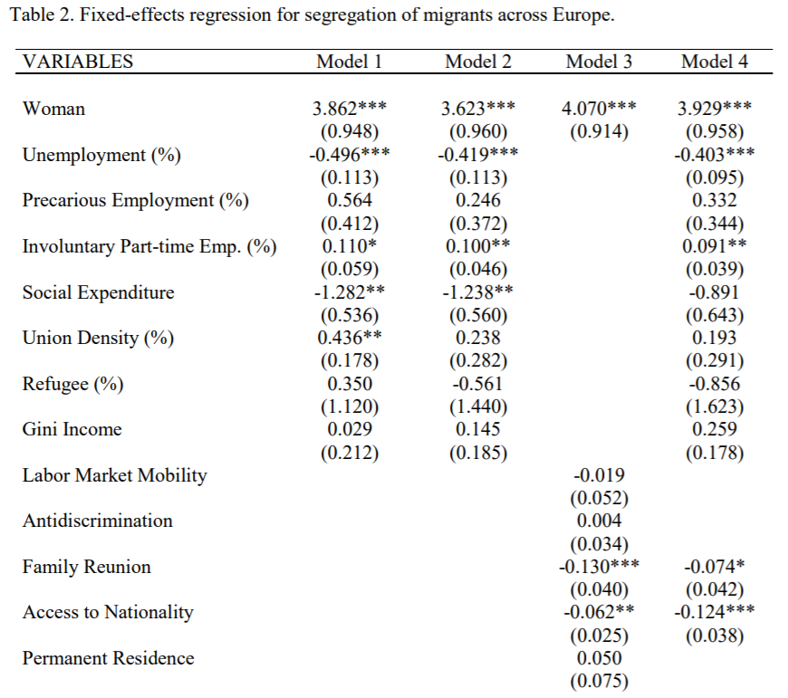
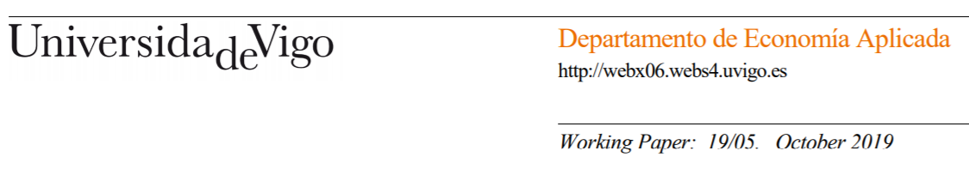
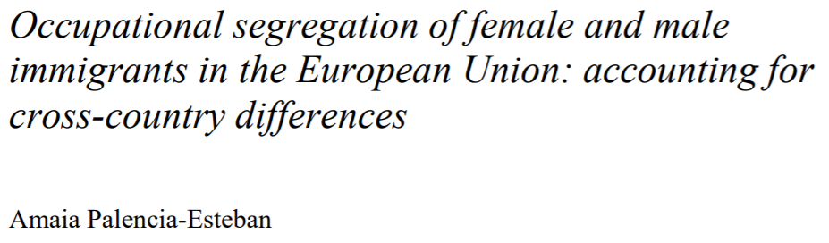
Few studies not yet conclusive on links between long-term security & (quality) employment

Slide 18
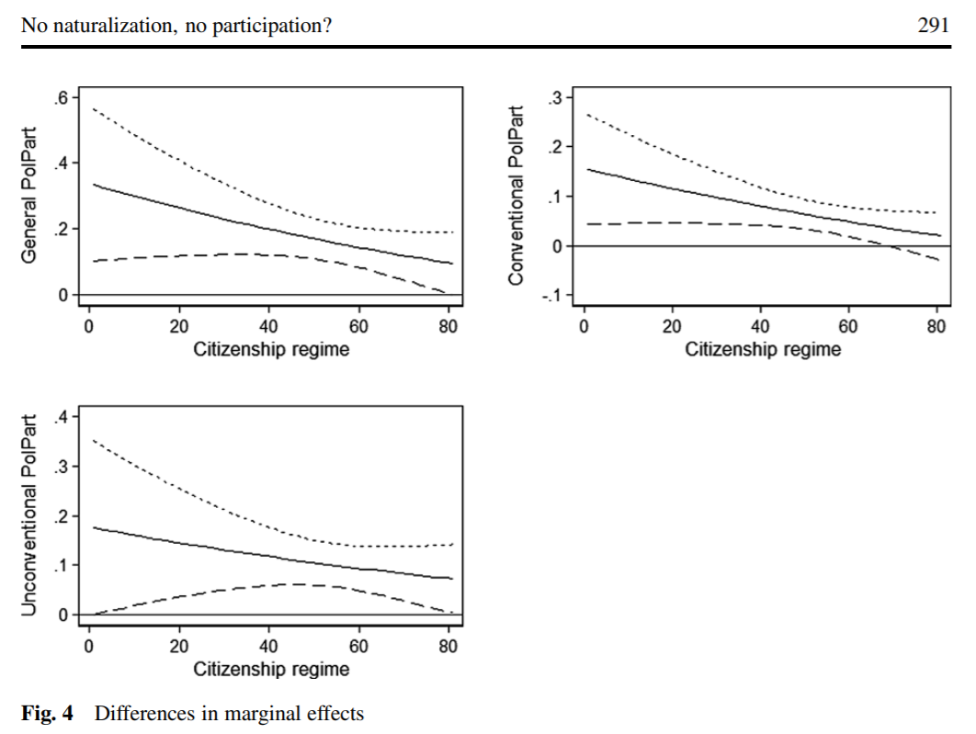
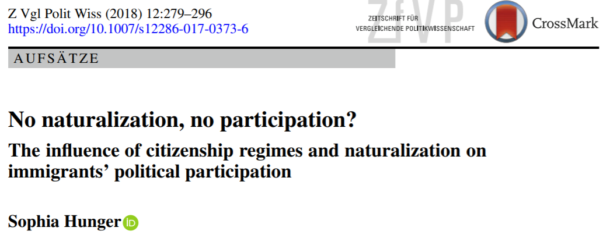
Dozens of studies on links between long-term security, belonging & public attitudes

Slide 19
MIPEX conclusions
Under Norway’s comprehensive but 2nd Tier policies, newcomers & citizens enjoy equal rights & opportunities, but no longer an equal sense of security.
Minor changes are sensitive and can have long-term consequences on Norway’s high levels of naturalisation, political participation, belonging & trust.
Long-term security linked to settlement & positive immigrant & public attitudes, but more research needed on links with employment & language outcomes
Clear but flexible path to family reunion, permanent residence & citizenship

